Slide 1


RPD Web Application - Frigoglass

Slide 2
Key Takeaways — RPD Platform.
Six capabilities on the RPD platform — from live portfolio visibility to forecast-grade delivery dates and management decision support
274 projects
3 hubs
52 weeks
4 surfaces
ACTIVE IN PORTFOLIO
INDIA · GREECE · ROMANIA
FORWARD SCHEDULING HORIZON
DASHBOARD · GANTT · KANBAN · CAPACITY
01
VISIBILITY
02
SCHEDULING
03
PRIORITIZATION
Real-time portfolio visibility.
Resource-constrained scheduling.
Logic and Data-driven prioritization
274 active projects tracked across three global R&D hubs — India, Greece, Romania — with live status monitoring from queue through commercialization.
The auto-scheduler enforces a strict one-engineer-one-design-task-per-week rule, eliminating unrealistic overlaps and exposing true capacity.
P1 → P4 priority buckets combined with financial metrics — TCOGS, Gross Margin, ROI — drive transparent, defensible project sequencing.
274
PROJECTS LIVE
1:1:1
ENGINEER · TASK · WEEK
P1–P4
+ TCOGS · GM · ROI
04
FORECASTING
05
LAB CAPACITY
06
DECISIONS
Delivery forecasting.
Design, Lab & Compliance resource optimization
Management decision support.
The simulation engine projects realistic completion dates and surfaces spill-over projects that won't finish inside the current year — early.
Automated chamber routing with weekly capacity tracking prevents lab bottlenecks across all testing facilities and hub combinations.
Interactive Gantt, Kanban and Capacity views give leadership actionable insight for resource reallocation, without waiting on weekly reports.
≤ wk 52
COMPLETING-THIS-YEAR FLAG
2 / 1
PROJECTS PER CHAMBER
4
LIVE DECISION SURFACES

Slide 3
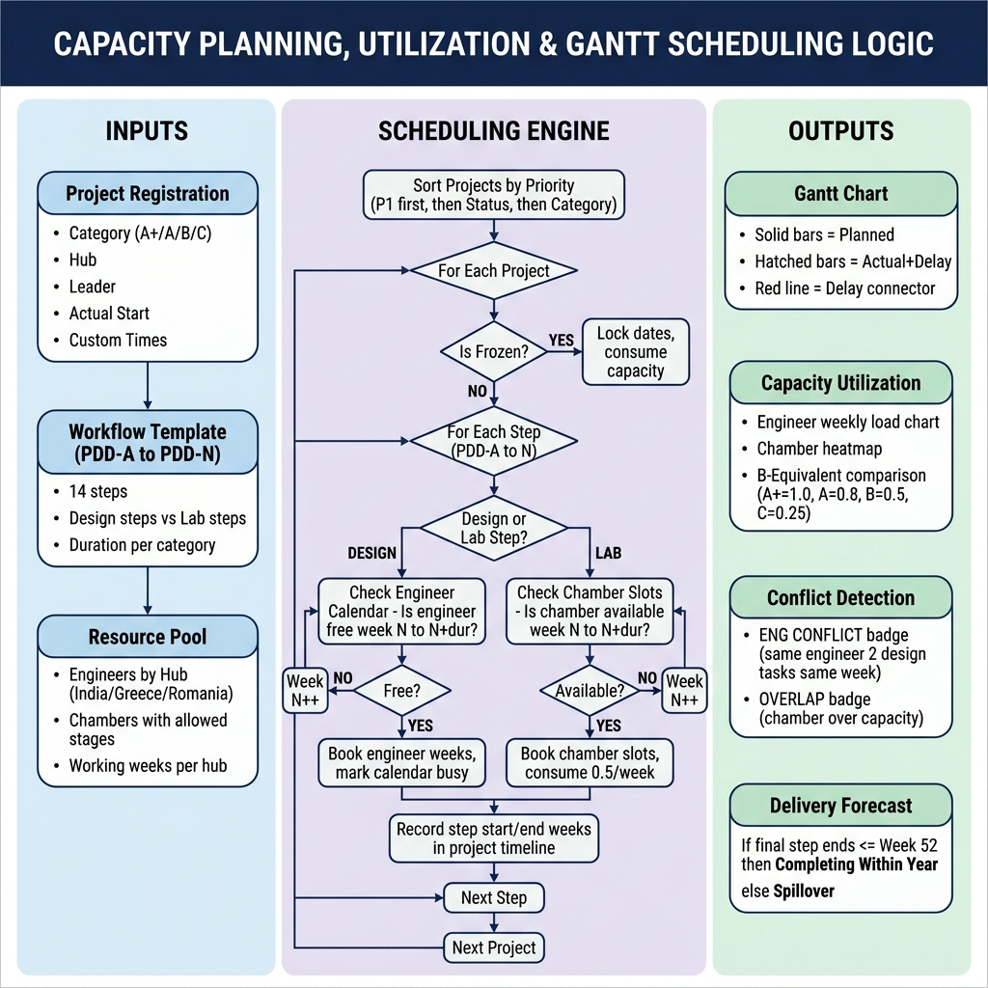
RPD Platform —Logic

Slide 4
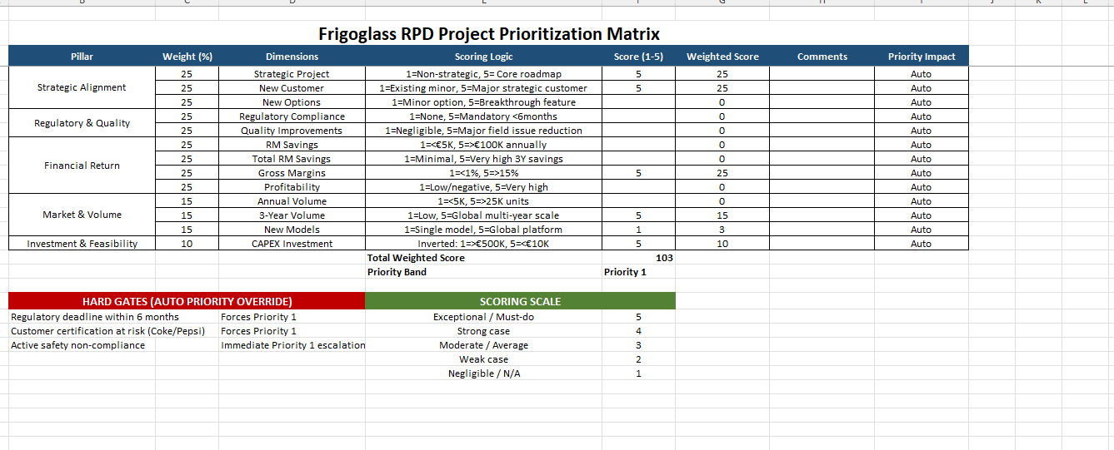

Slide 5
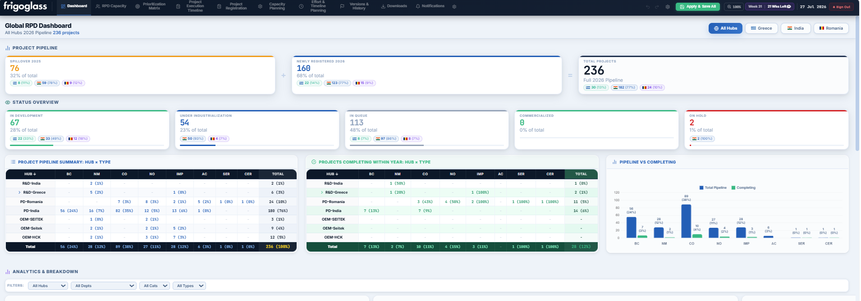
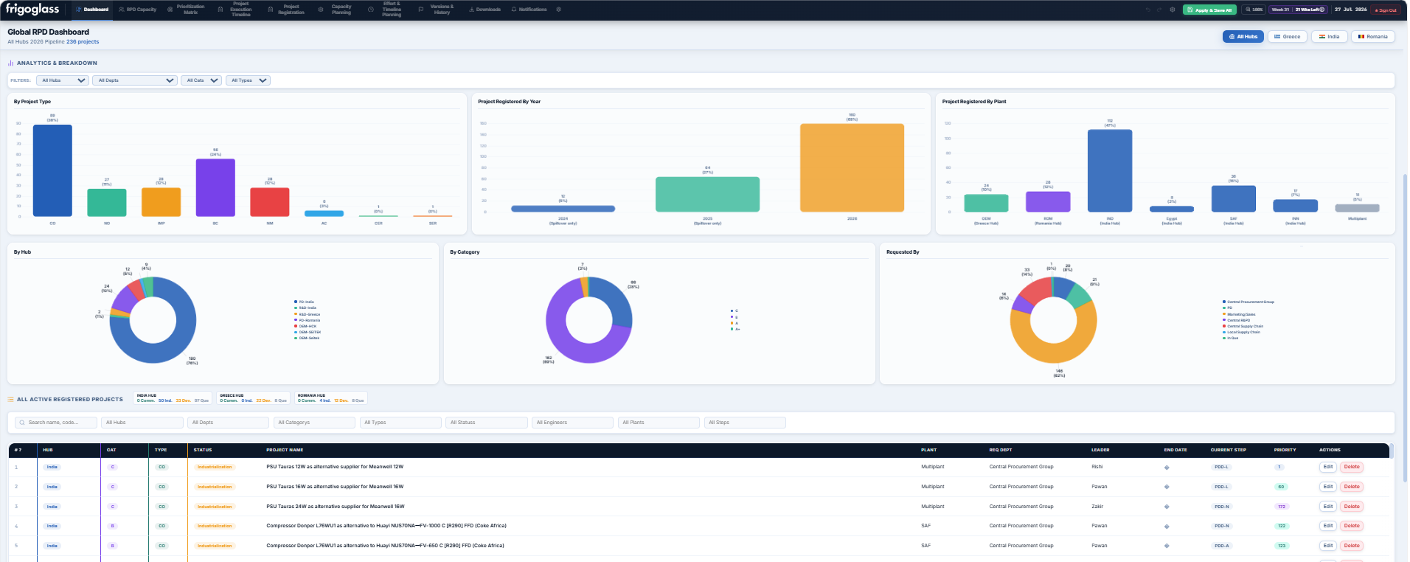

Slide 6
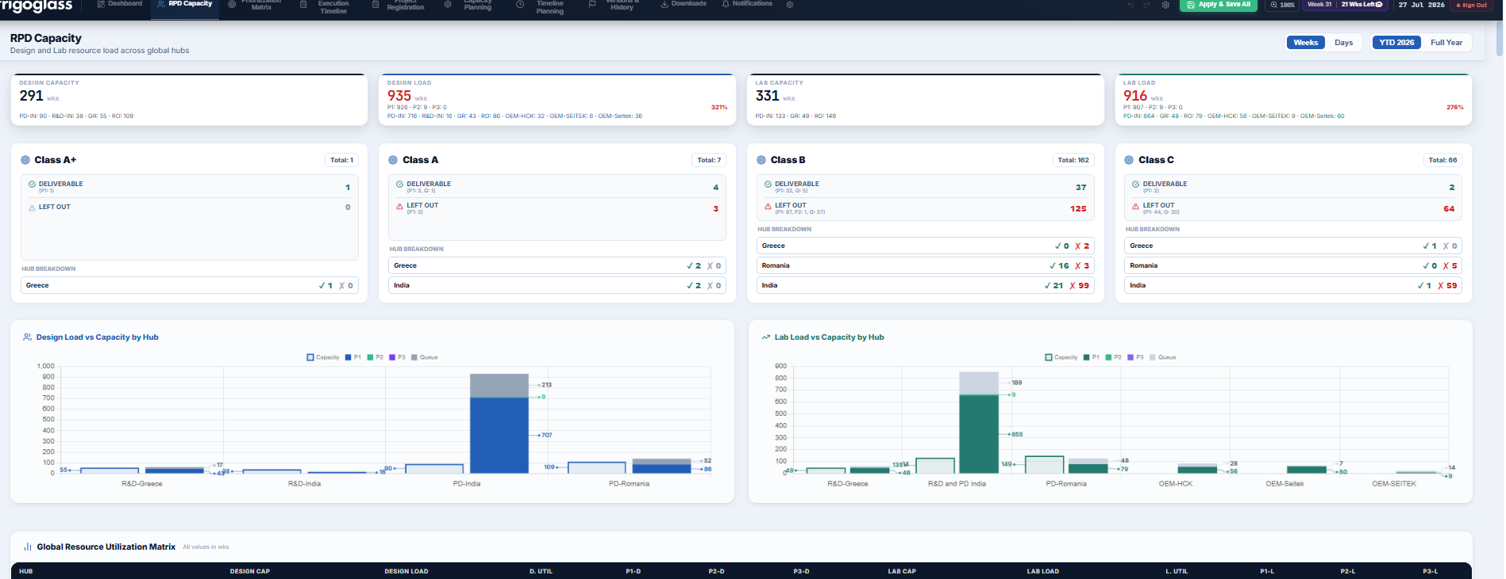

Slide 7
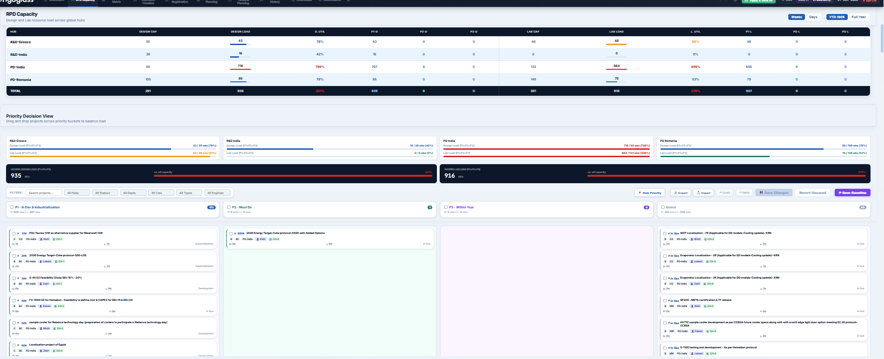

Slide 8
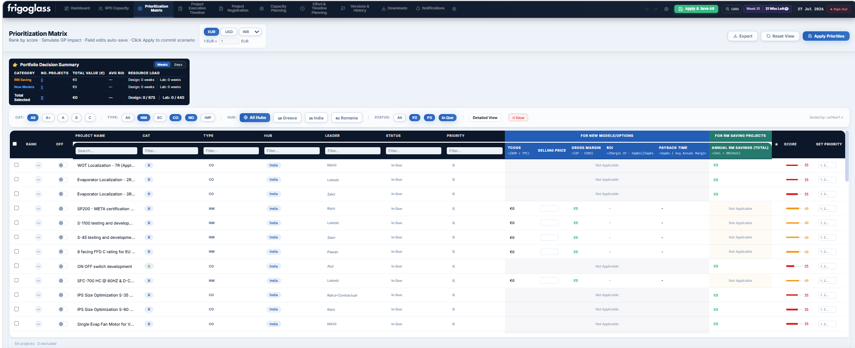

Slide 9
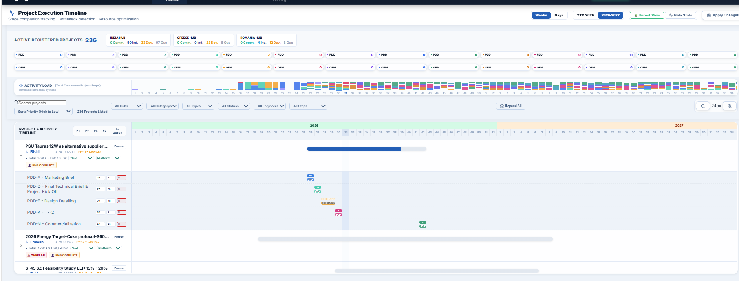

Slide 11
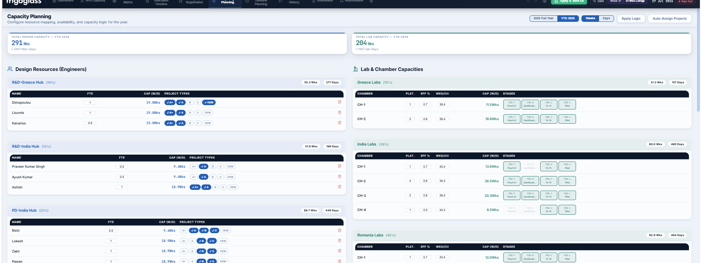

Slide 12
Thank you

